Slide 1
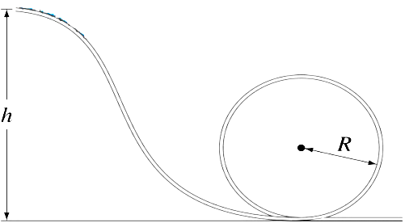

Homework 7 (Chap 9)
1. Block A with mass 0.8 m is on block B with mass m. Both are initially at rest. Now a bullet with mass 0.2m and velocity 5 v₀ hits and is embedded in block A. Assume all the surface are frictionless.
a) What is the velocity v_{A} of block A immediately after the collision?
b) Eventually, the block A slides down block B. Assume the height H = 2v₀²/g, what is the velocity u_{A} of block A and velocity u_{B} of block B after separation? . .
Box A
Fig 3
A
Fig 2
v₀
H
v₀
3m
Fig 1
m
B
H
Box B
2.(15pts) As shown in Fig. 2, a block of mass 3m with height H sits at rest on a frictionless table. A small cube of mass m with velocity v₀ moves toward the block. Assume that all the surfaces between the inclined block, cube and the table are frictionless.
(A) (4pts) What are the velocities of the cube and the block respectively when the cube reach the highest position on the block but remains on the block?
(B) (6pts) What is the maximum velocity of v₀ , such that the cube reaches the height H but does not run over it? Write your answer in terms of m, H, and g
(C) (5pts) Once the cube reach the height H, it begins to slide down. What are the velocities of cub v₁ and the block v₂ when they separate. Write your answer in terms of m and v₀.
3. Box A of mass m is released from rest at the top of height h, shown in Fig. 3. It collides with box B of mass 2m elastically, and the Box B move along a circular vertical loop. What is the minimum height h such that the box B can complete the circular motion?

Slide 2
1. Block A with mass 0.8 m is on block B with mass m. Both are initially at rest. Now a bullet with mass 0.2m and velocity 5 v₀ hits and is embedded in block A. Assume all the surface are frictionless.
a) What is the velocity v_{A} of block A immediately after the collision?
b) Eventually, the block A slides down block B. Assume the height H = 2v₀²/g, what is the velocity u_{A} of block A and velocity u_{B} of block B after separation? . .
v₀
A
B
H
(a) Embedded process:
Momentum conservation:
(1) ➔
➔
--- (3)
(2) ➔
u_{B} is Replaced by (3):
(b) After separation:
Momentum conservation:
➔
--- (1)
Mechanical Energy conservation:
Make no sense, since block A is moving to the right.
--- (2)
and

Slide 3
2.(A)
2.(B)
2.(C)
Energy conservation:
Momentum conservation:
H
v₀
3m
m
1 pt
1 pt
Momentum conservation:
Energy conservation:
1 pt
2pts
1 pt
3 pts
When the cube reach the highest position on the block
3pts
3 pts

Slide 4
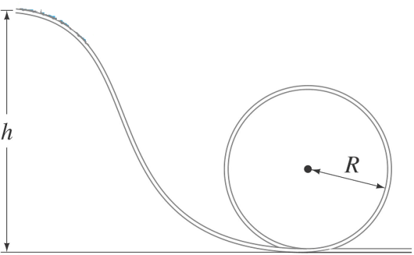
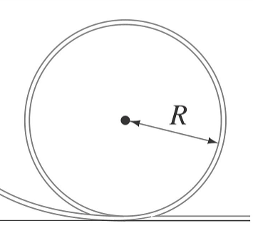
3. Box A of mass m starts release from rest at the top of height h, as shown in Fig. 1. It collides with box B of mass 2m elastically, and the Box B move along a circular vertical loop. What is the minimum height h such that the box B can pass the top of the loop?
Box A
Fig. 2
Box B
The problem can be separated into three stages.
Stages III: the box B moves along the loop.
The criteria that the box B move to the top.
Stages I: the box A moves down.
The process is energy conservation.
when
Stages II: Box A collides with box B.
The process is elastic.
Along the loop, energy is conserved

